Slide 1
PRONUNCIATION AND ACCENT CORRECTOR
ON COMMUNICATION DEVICES

Slide 2
INTRODUCTION
Importance of Good skill of communication.
Mispronunciation in frequently spoken languages mainly ‘ENGLISH’.
Training of Accent correction and pronunciation in Multi-National BPO’s.
The Real-time Application which corrects ACCENT AND PRONUNCIATION while communicating on cell phones, video chat.

Slide 3
SIMPLE BLOCK DIAGRAM
Speech database
Speech to text convertor
Corrected database in Text
GUI with Conversation in Visual Text form
Text & Phonemes Database
Text to speech convertor with corrected accent
Input speech
Update Database
Corrected speech

Slide 4
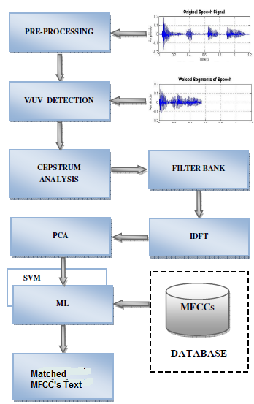
SPEECH TO TEXT CONVERSION

Slide 5
Automatic Speech Recognition (ASR) is process by which computer maps Acoustic speech signals to text.

Slide 6
GUI AND PROCESS TO UPDATE DATABASE
ON/OFF
UPDATE
AUTO-SUGGESTION
EMPLOYEE:

Slide 7
Speech to Text conversion Result from employee will be displayed with the help of GUI.
Flexibility is provided to employee to update database, by clicking ‘UPDATE’ button and inputting actual word spelling and Mispronounced word of employee.
Flexibility is provided to employee to bypass the accent & pronunciation correction using ON/OFF button.

Slide 8
TEXT TO SPEECH CONVERSION
Input Text
Text Analysis & Text Detection
Text Normalization & Text Linearization
Phonetic Analysis
Acoustic Process
Prosodic Modeling & Intonation
Speech as Output

Slide 9
It is reverse process of speech to text conversion.
This conversion is brought out by use of 44 phonemes in English language.
Input Text is first converted in phonetically analyzed text.
ex. Girl g/ur/l
We can use anybodies voice database for
final speech synthesis.

Slide 10
ACCENT CORRECTION
Accent is way of pronunciation by a speaker with shared characteristic of a certain locality within the community.
Two choices on output side-
1.corrected accent in random voice output - directly use random database in speech to text conversion process.
2.corrected accent in speaker’s voice output- using Voice Morphing Technology

Slide 11
VOICE MORPHING
Voice morphing is a technique for modifying a source speaker’s speech to sound as if it was spoken by some
designated target speaker.
The Technology modifies the pitch, speed, tone and other key attributes of voice to according to correlation between two voices.

Slide 12
BLOCK DIAGRAM
Speaker’s voice
Accent Database
Spectral Detail
Spectral Detail
Morph correlator and modifier
Speaker’s voice with corrected accent

Slide 13
DRAWBACKS
Time-delay in process
Change in characteristics of speech according to speaker’s emotions are not
reflected in output speech.
Large Database required in system.

Slide 14
CONCLUSION
This Application is very user friendly and useful for people having dull accent and bad pronunciation.
It can be helpful for those people who have stammering problem.
With little modification will convert Foreign accent to Indian version which helpful for Interaction too.

Slide 15
Thank You…..1111

